Slide 1

Placement Management System

Slide 2
Project Overview
Definition
Our system aims at providing the compatibility to simplify the process of placement for College Students, various Companies visiting the campus for recruitment and even the College TPO.
The system consists of a company login where various companies can view a list of students in that college and also their respective Academic details and assign offcampus Job announcement and also request TPO for job announcement. Also see the applied student list.
TPO can add student details, view student details and announce oncampus job to student. TPO can also see the company details and requested company’s job request.
The software system allows the students to create their profiles or TPO added students login. Students can view a list of companies. See oncampus/offcampus job details and applied on it.

Slide 3
Project Overview
Scope
Our project has a big scope to do. We can store information of all the students, Companies, TPO. Various companies can access the information. Company announced jobs. Students can maintain their information and can update it. Student can view and apply the Oncampus/Offcampus job. All Information about placement can manage by collage respective officers(TPO). And there are many more scope…

Slide 4
Project Overview
Objective
The main objective of the project on “Placement Management System” is to manage the details of students, company, Training and placement officer.
Placement activities becomes more interactive, automated and effective.
User friendly interface.
Save time & work load for placement cell.
To increase the accuracy and efficiency of placement procedure.
Management of Student Data as well Company Data.
Analysis of overall Placement.

Slide 5
Project Overview
Hardware and Software Requirements (minimum requirements to run your system)
There are no such specific hardware requirements other than basic requirements such as a computer with good internet connectivity and a decent browser.
Software requirements:
Web Browser: Mozilla firefox, Edge, Chrome, Safari
Language Nodejs, JavaScript (Bootstrap 4, jQuery)
Mysql database

Slide 6
Summary of Work Done
System design model | Agile model
Number of use cases prepared | 3
Number of sequence diagrams prepared | 5
Number of database tables prepared | 5
Number of classes prepared and implemented | Many
Learn Figma Tool (GUI design) | https://www.figma.com/file/6AsHxbyJsVLEh0SoFROrWa/Placement?node-id=0%3A1
Digital User Manual | https://drive.google.com/drive/folders/146oMXJz-F0vMZ23rxrEzGzgejihbVT3t?usp=sharing
GitHub Link | https://github.com/dk1307/Placement-Management-System

Slide 7
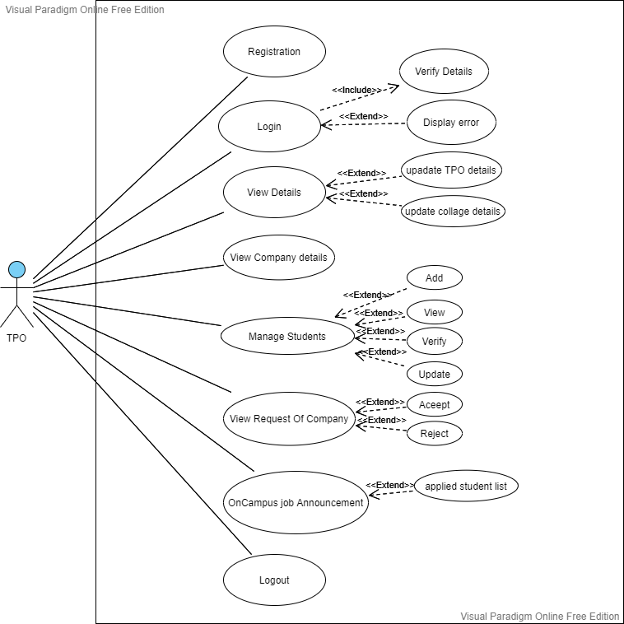
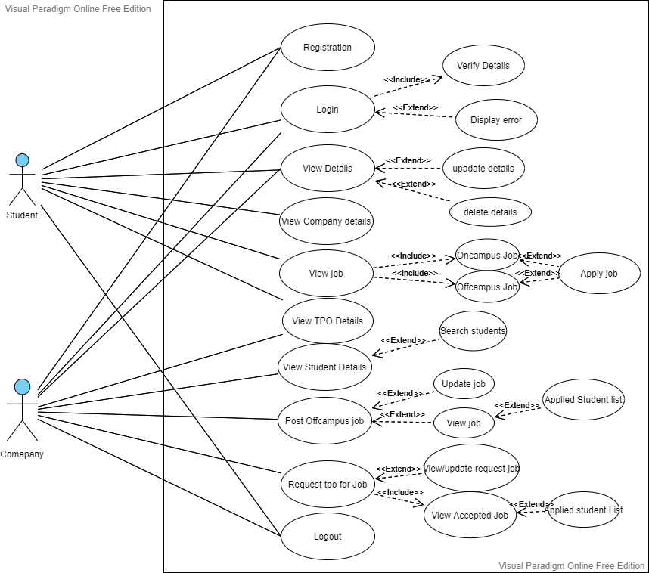
Use Case Diagram
(a) TPO Use Case Diagram
(b) Student and Company Use Case Diagram

Slide 8
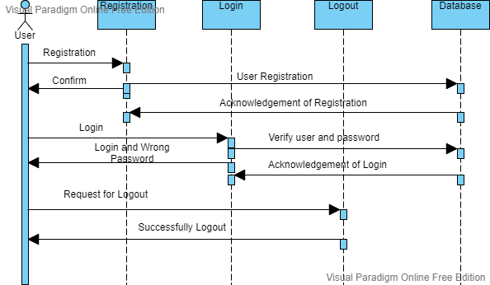
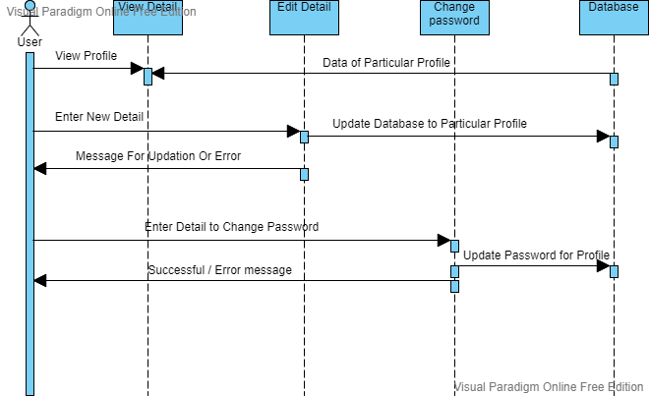
Sequence Diagram
(a) User (Login Register Logout)
(b) User (View/Edit/Change password)

Slide 9
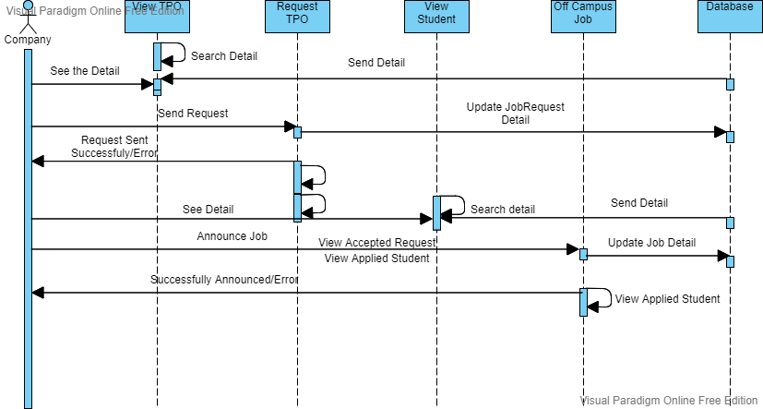
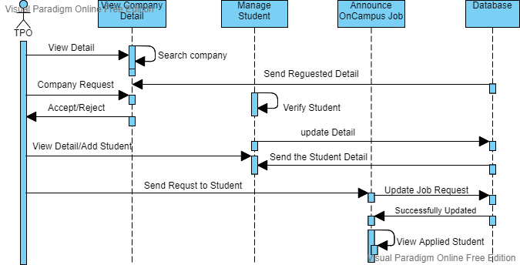
Sequence Diagram
(c) Company (HR)
(d) TPO

Slide 10
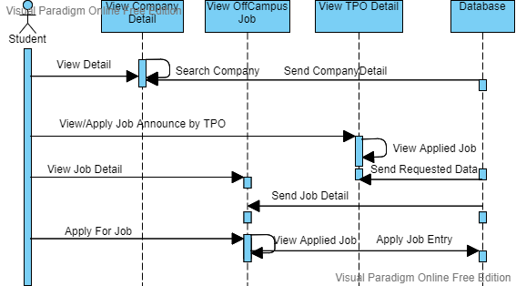
Sequence Diagram
(e) Student

Slide 11
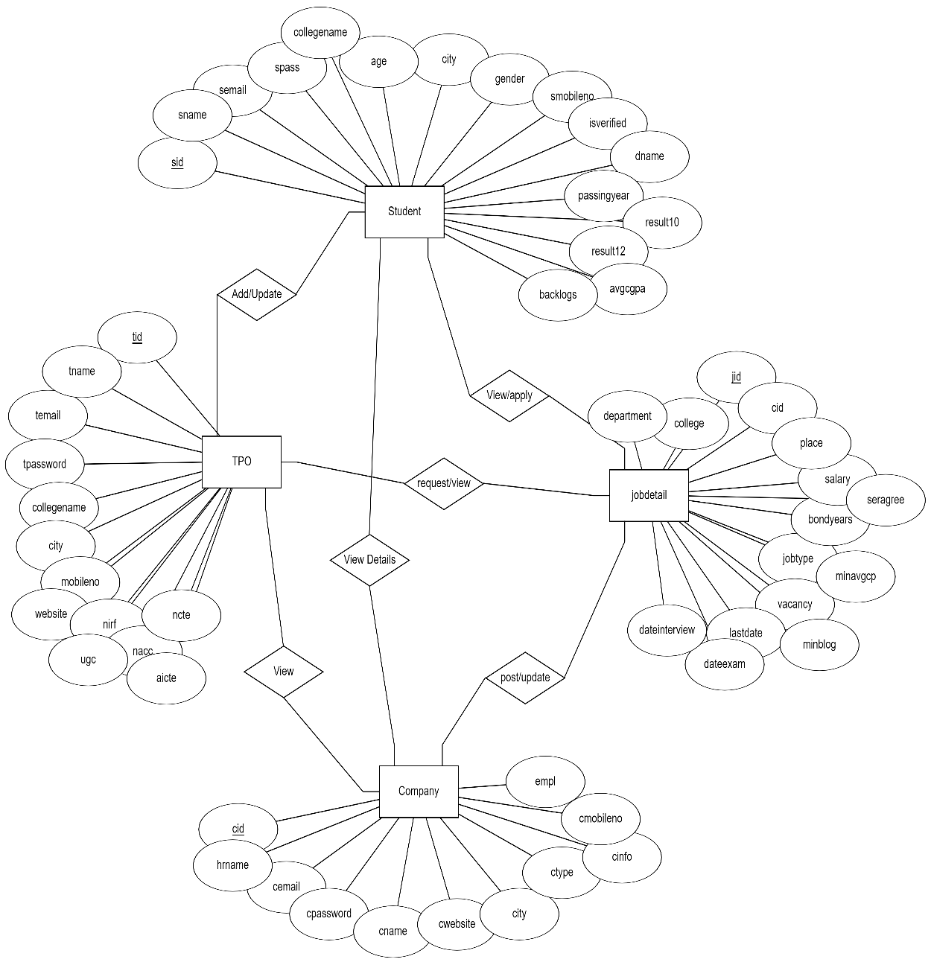
E-R Diagram

Slide 12
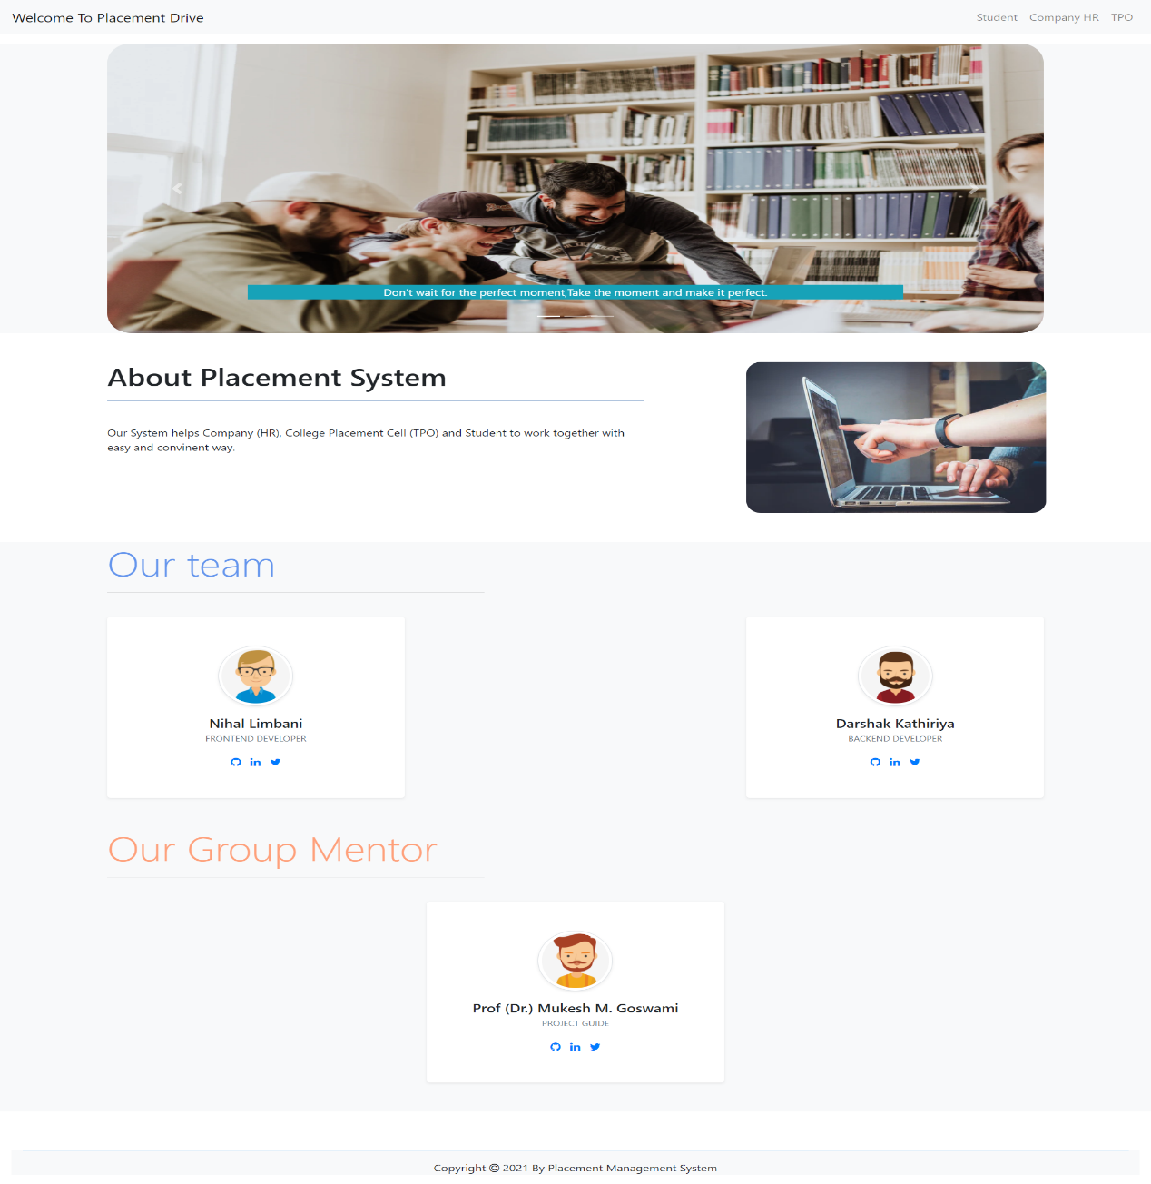
Screenshots
Home Page

Slide 13
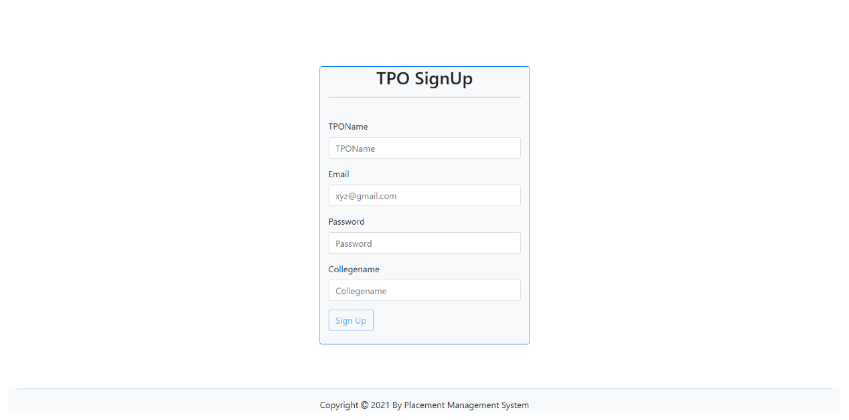
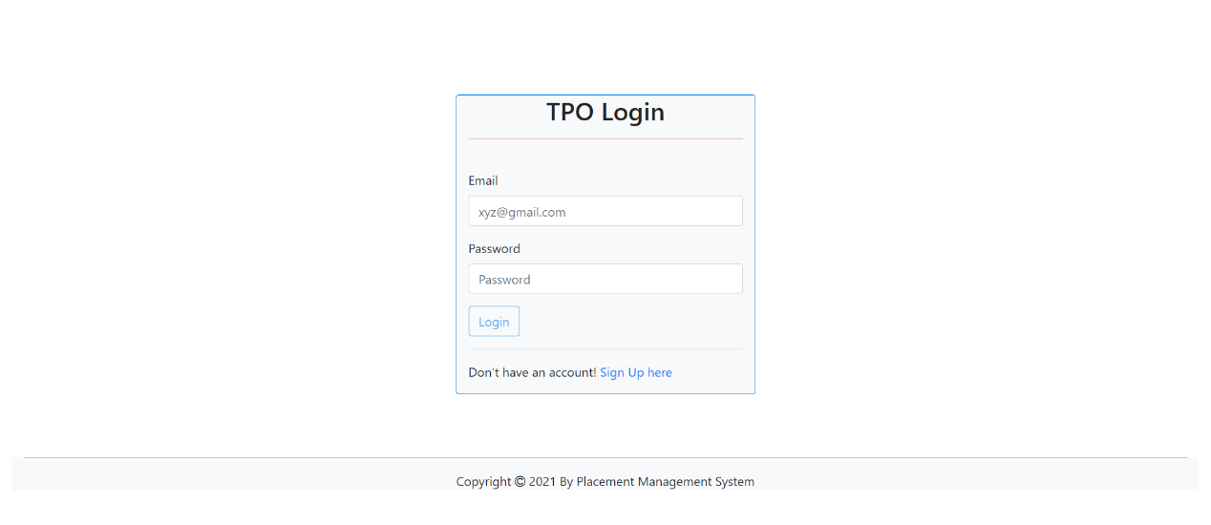
Screenshots
Login Page of TPO
Registration Page of TPO

Slide 14
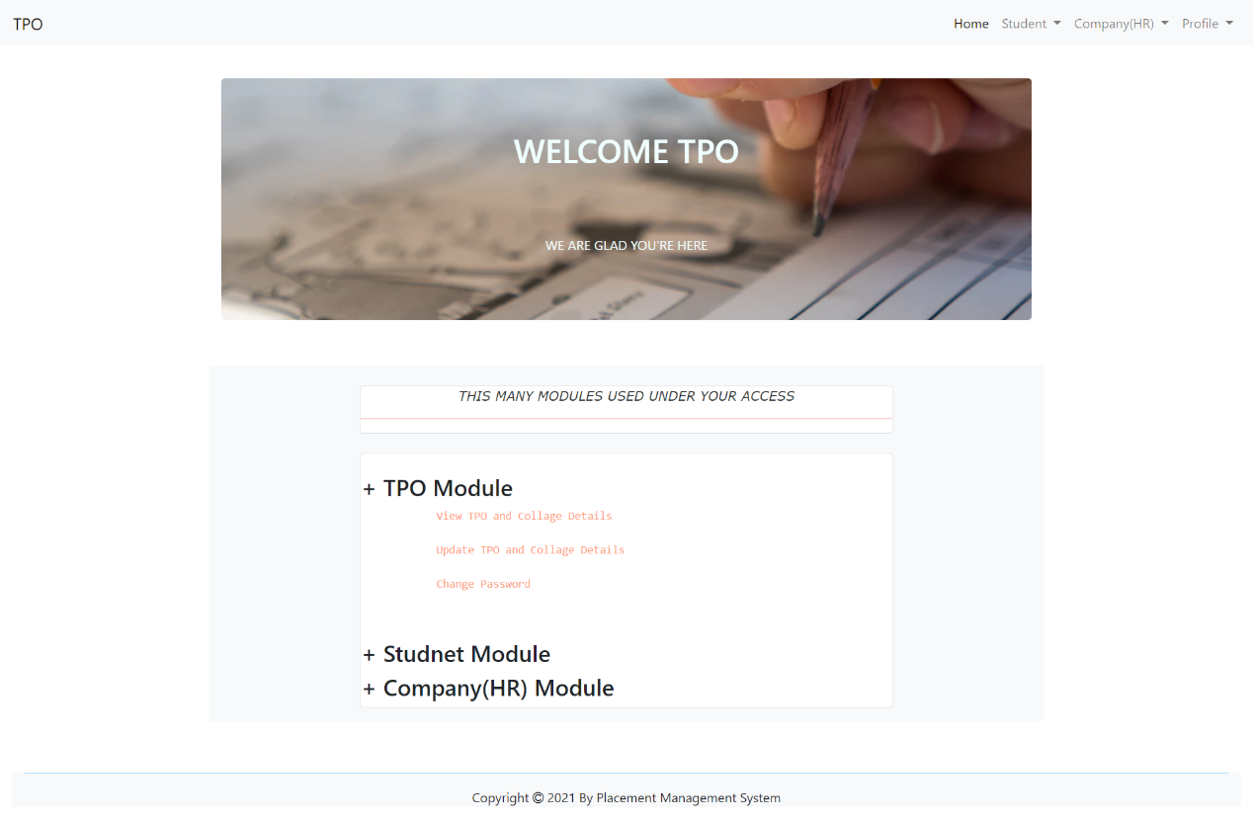
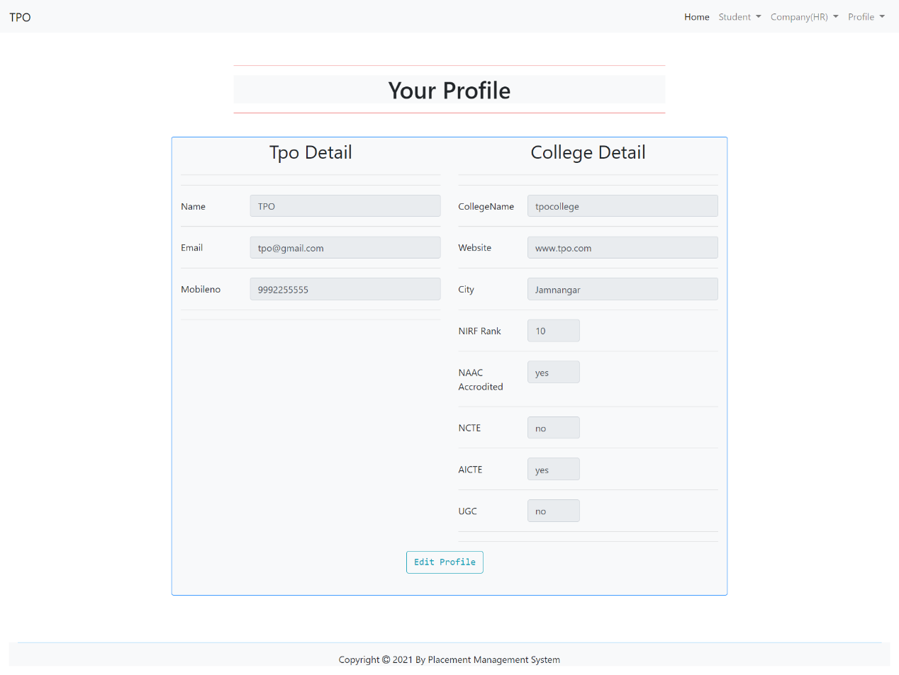
Screenshots
TPO Home Page
TPO View Profile

Slide 15
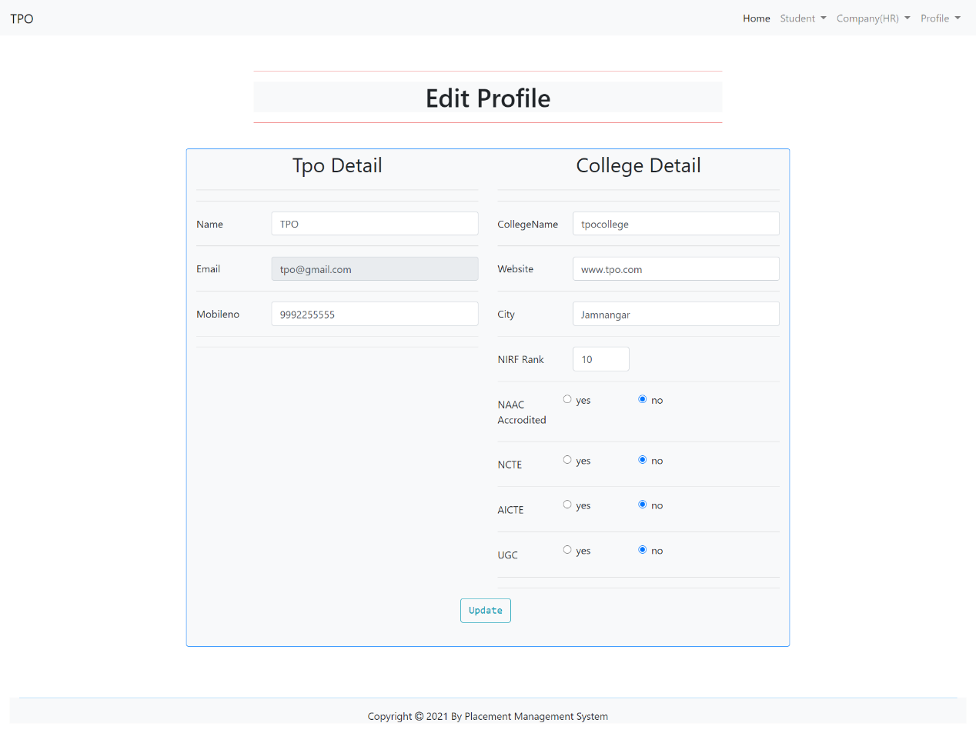
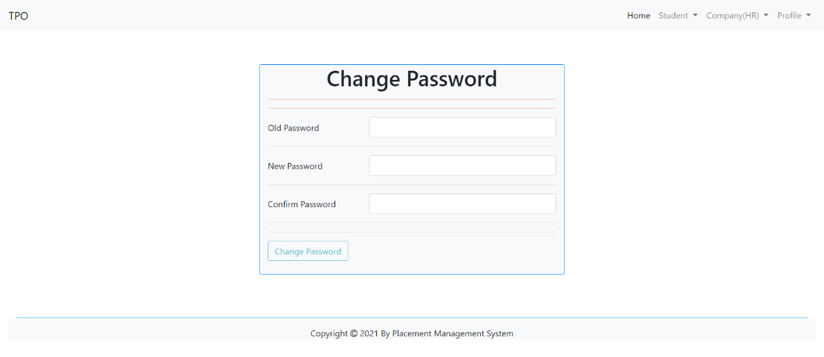
Screenshots
TPO Edit Profile
TPO Change Password

Slide 16
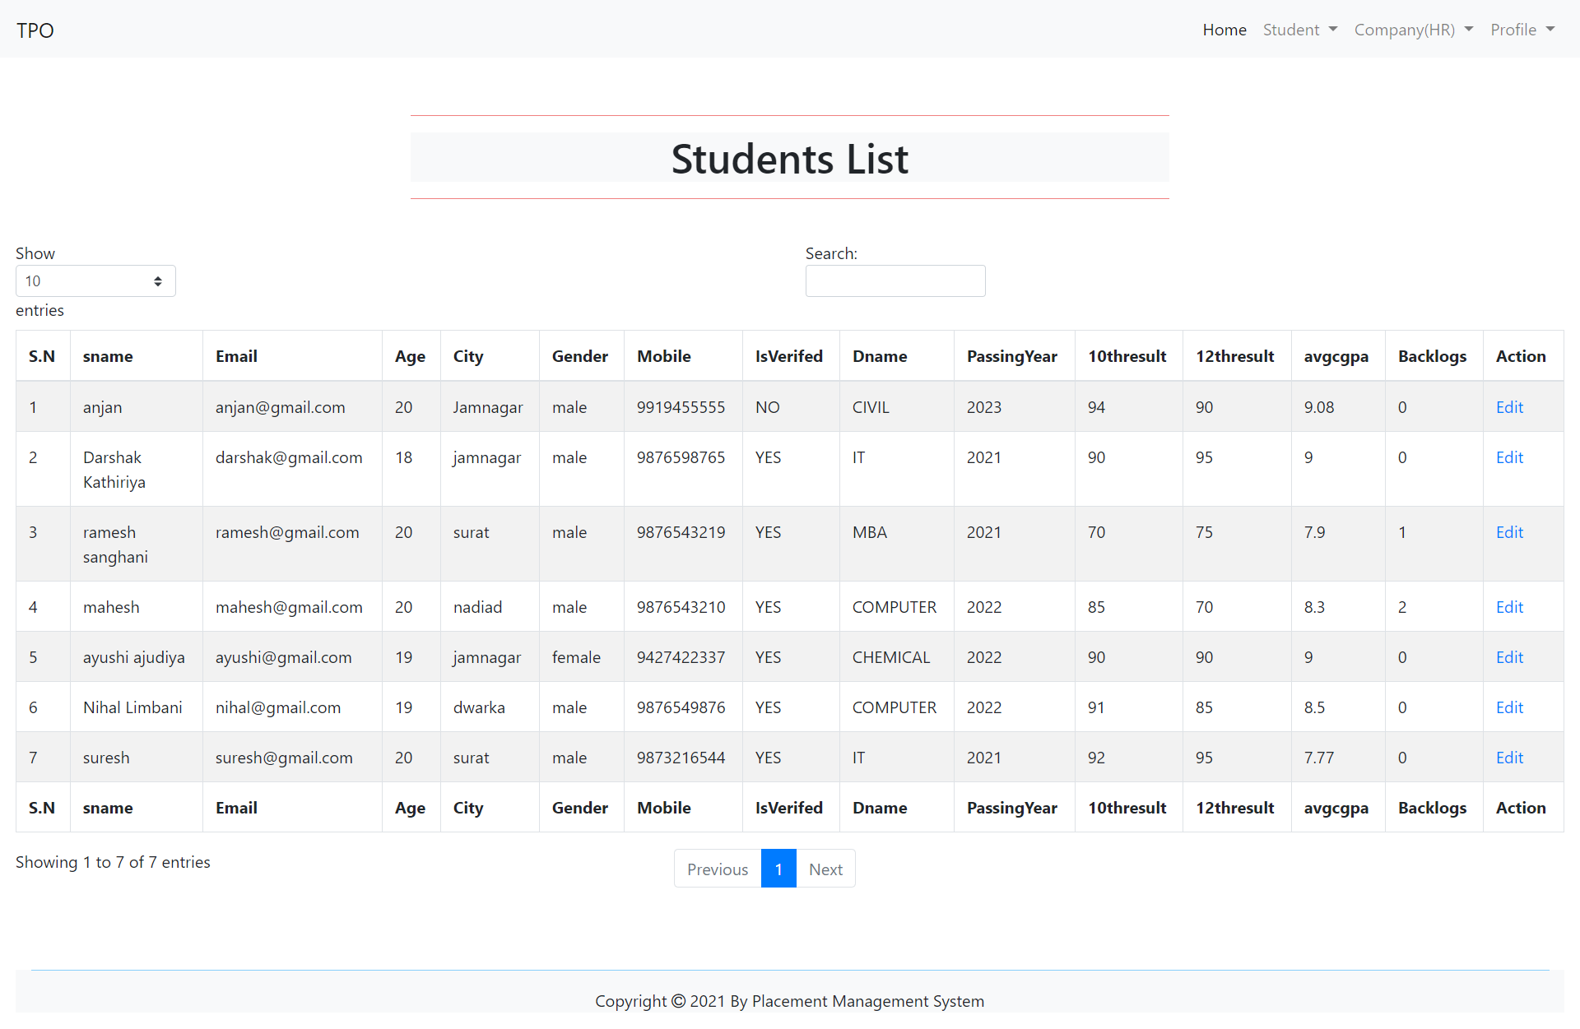
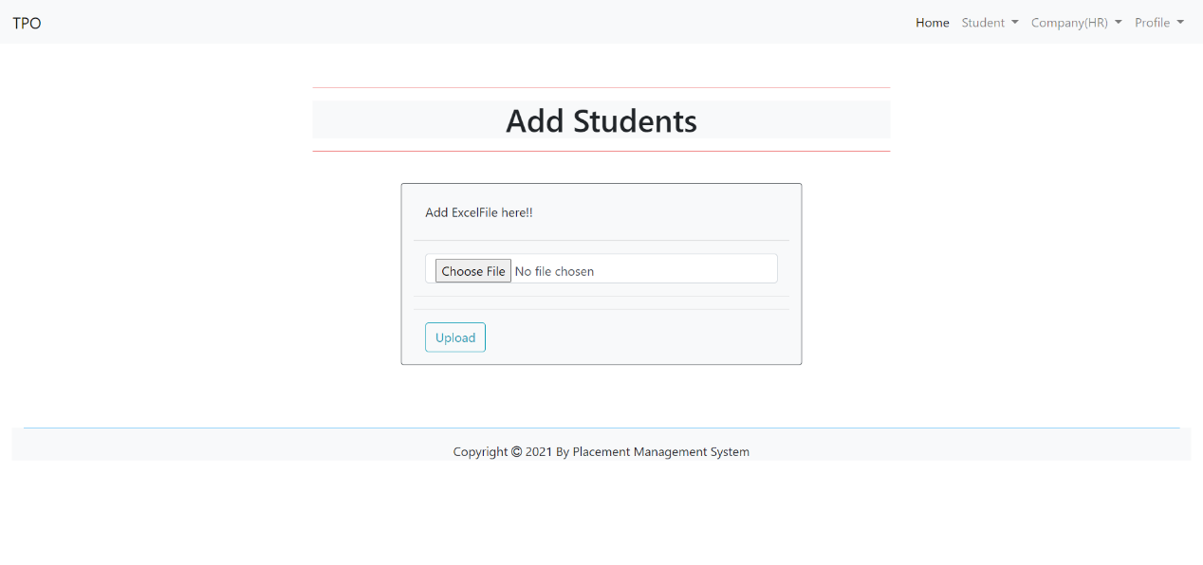
Screenshots
TPO Add Students
TPO View Students List

Slide 17
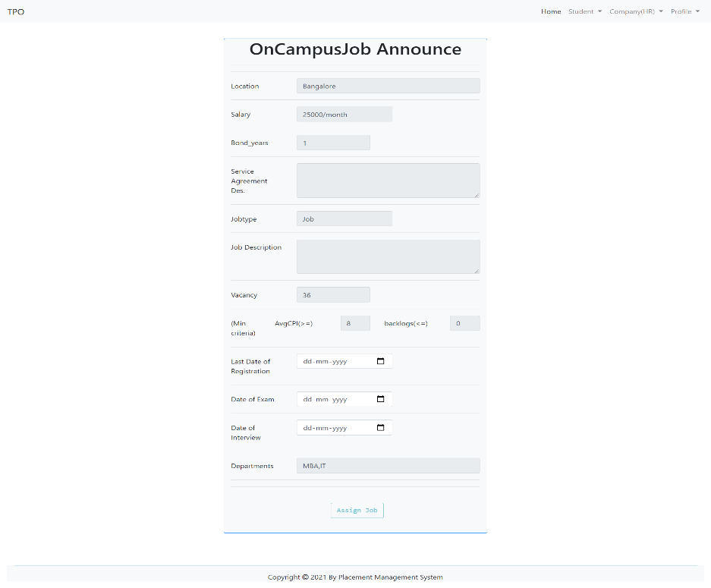
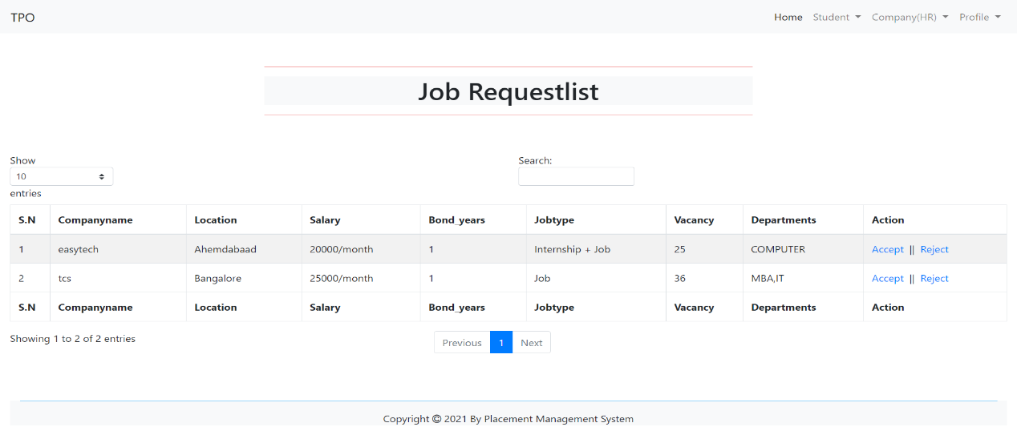
Screenshots
TPO View Job Request
TPO Announce Oncampus job

Slide 18
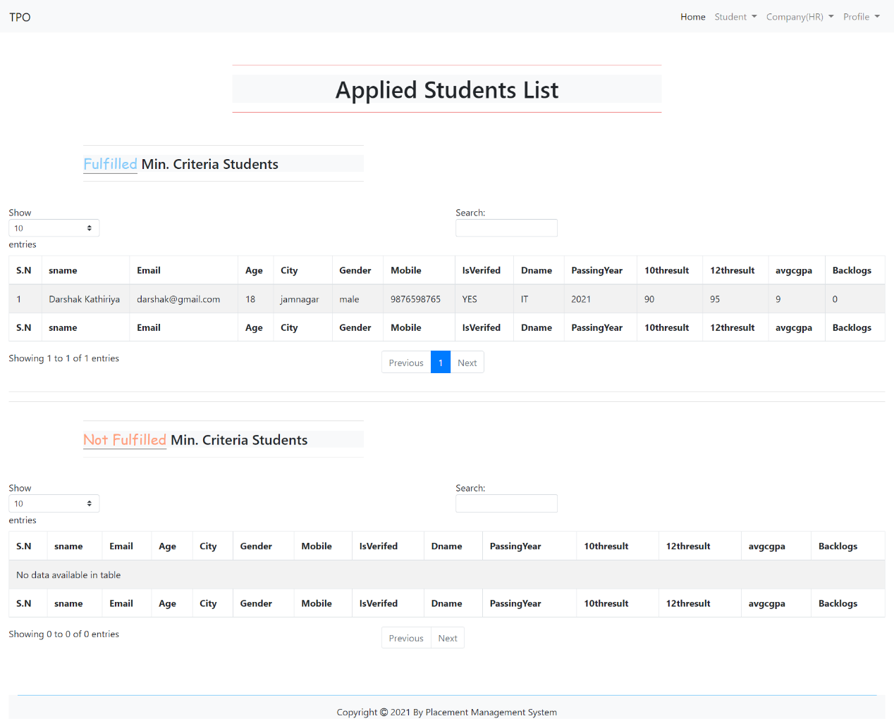
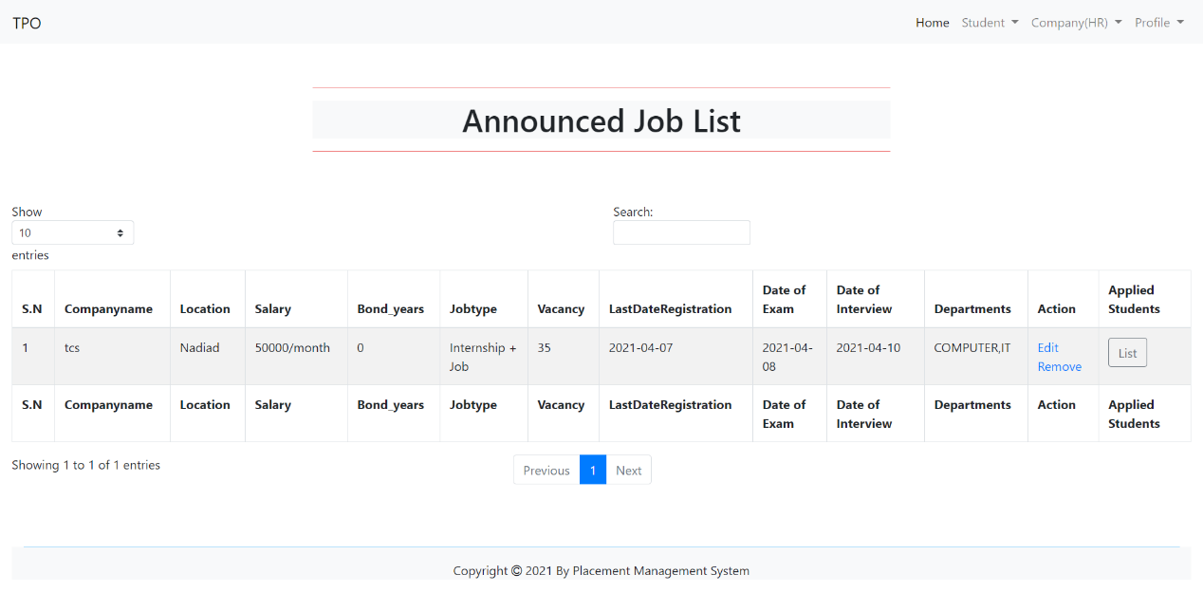
Screenshots
TPO View announced Job
TPO See Applied Students List

Slide 19
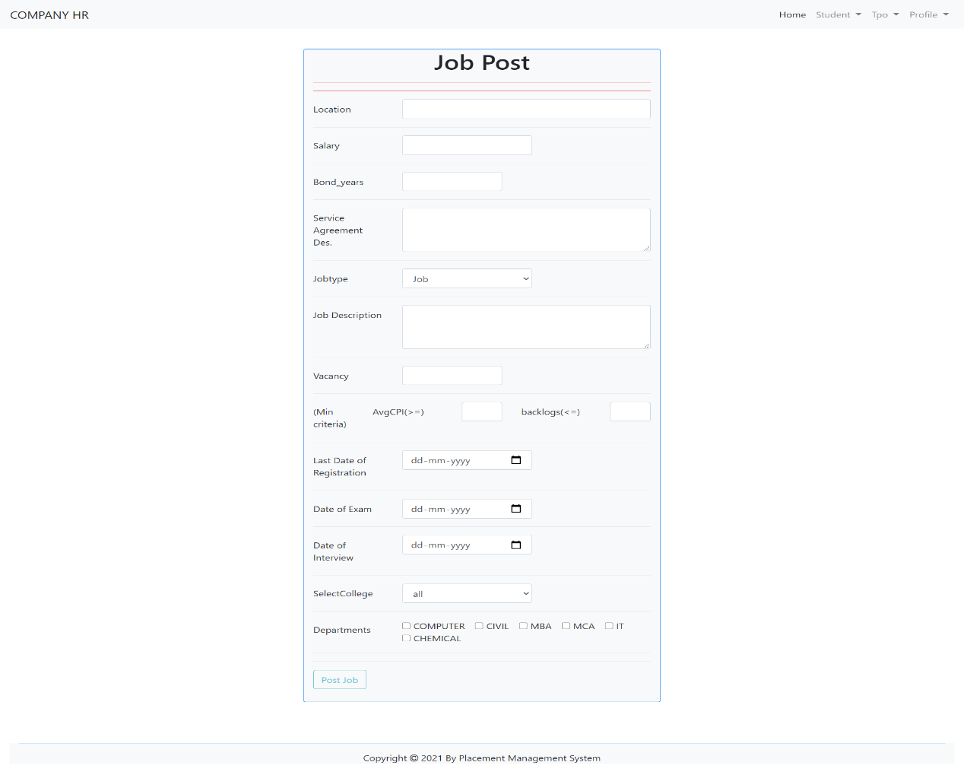
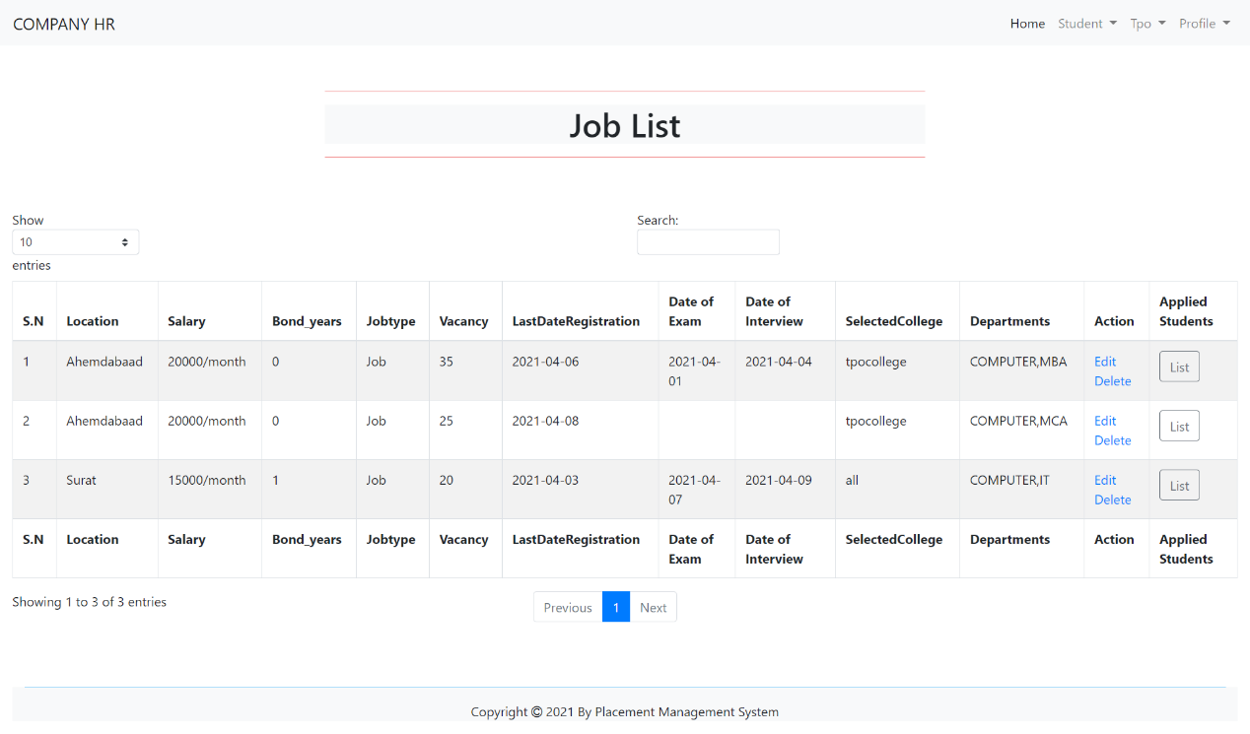
Screenshots
Company (HR) OffcampusJob announce
Company(HR) Annouced Job List

Slide 20
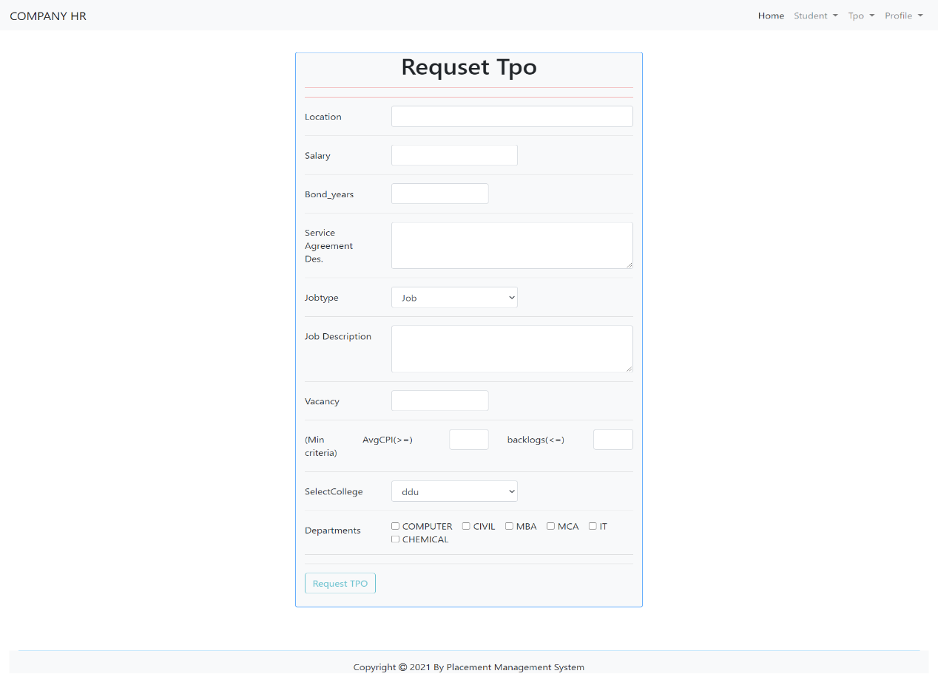
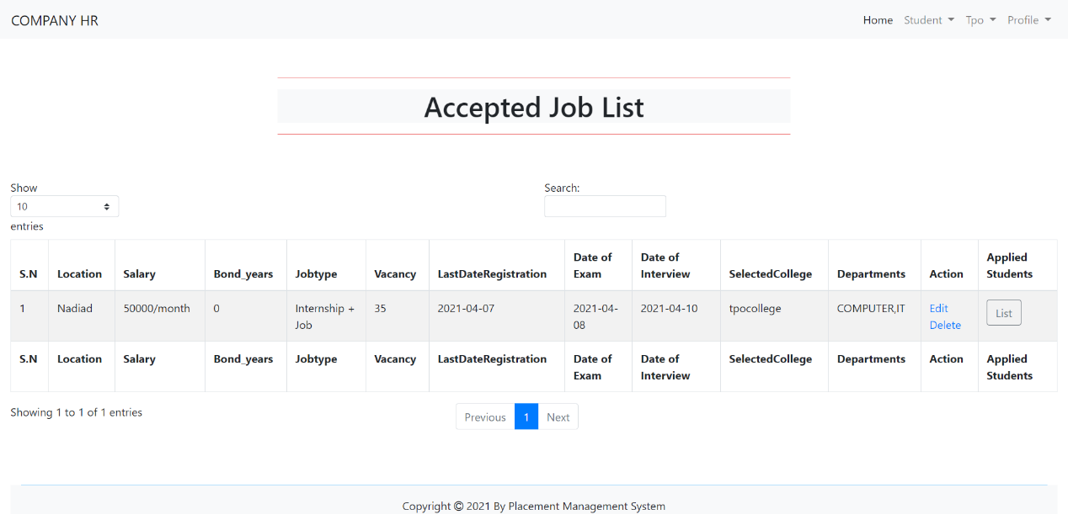
Screenshots
Company (HR) Request TPO for OncampusJob
Company(HR) Accepted req & announced Job List

Slide 21
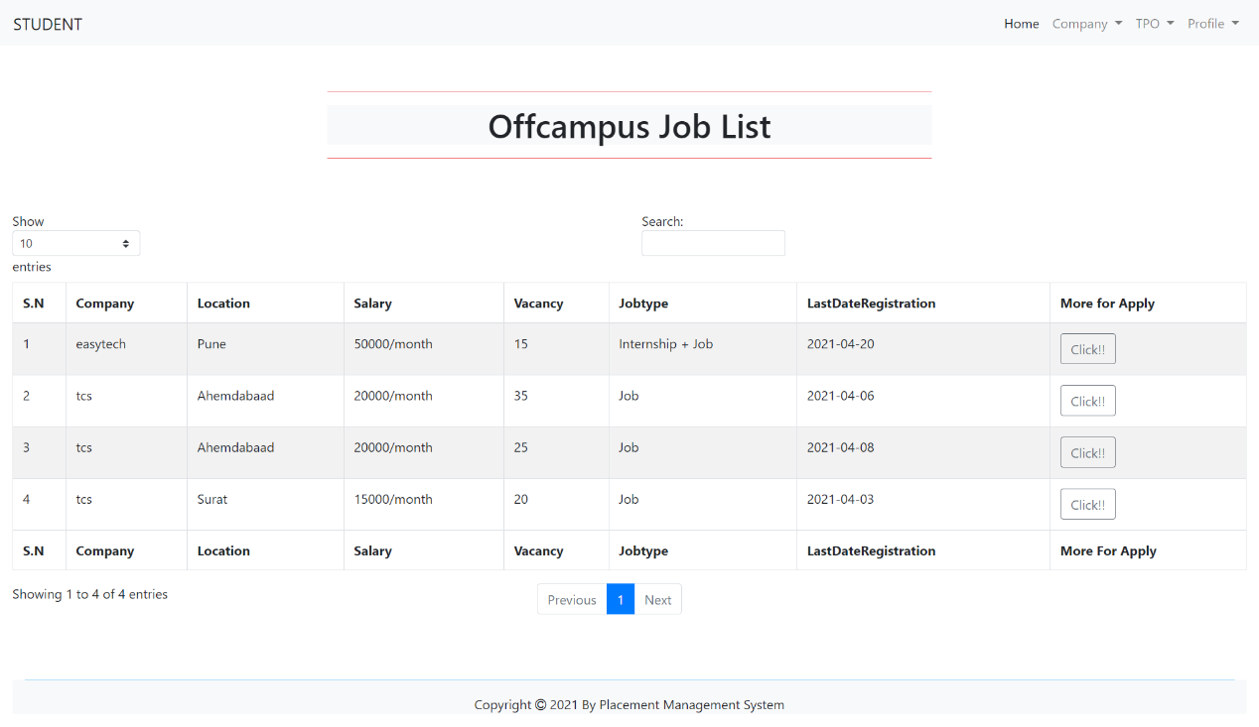
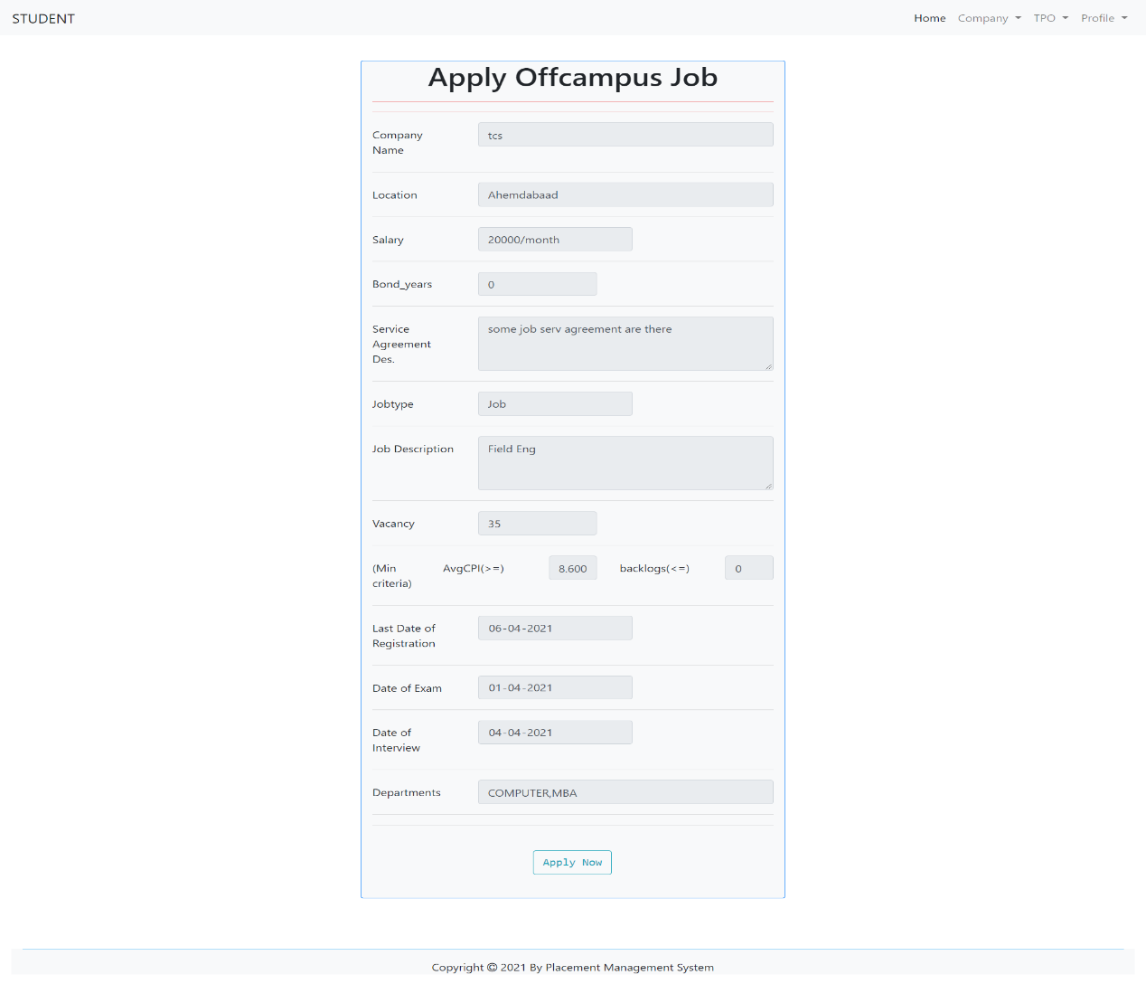
Screenshots
Student Offcampus Job List
Student offcampus apply for Job

Slide 22
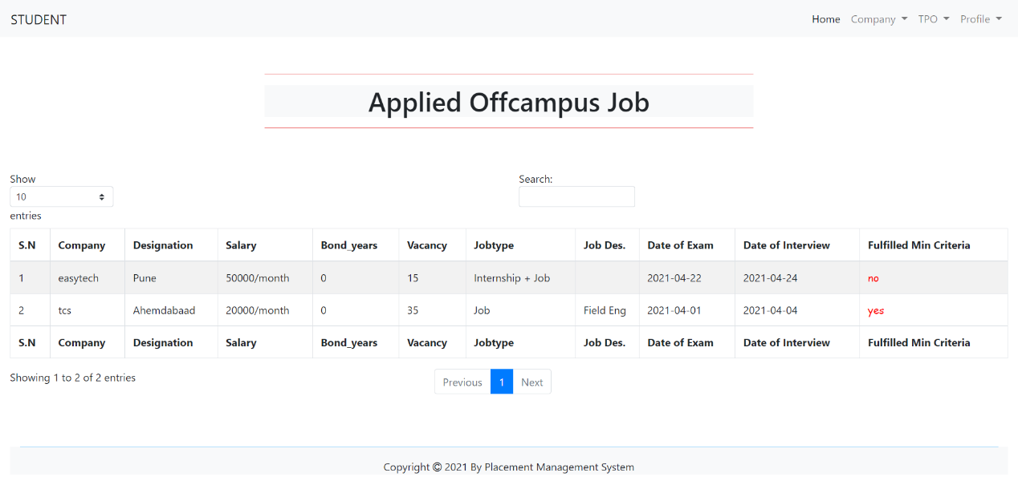
Screenshots
Student offcampus applied Job Details

Slide 23
Future Enhancement
Better UI will be prepared.
Some of the current new flaws if found we would be resolving them as soon as possible.
We will try to implement more functionality for TPO, Company (HR) as well as Students. Ex. In Company (HR) will update selected students List on our system, TPO and Student will see that details.
We will try some of our system function to more advance.

Slide 24
Conclusion
According to us, this project gave all of us the confidence to believe in ourselves and a great experience of how to work as a team. It also boosted our technical coding as well as time management skills.
To complete this project, first We understood the need of such system then We gathered relevant data and Started work on it. After that We started designing and coding phase for actual implantation of the system.

Slide 25
THANK YOU
NAME: KATHIRIYA DARSHAKKUMAR
ROLL NO: IT057
ID: 18ITUOS097
NAME: LIMBANI NIHAL
ROLL NO: IT064
ID: 18ITUOF051

